Slide 1

ODL-Mininet Integration

Slide 2
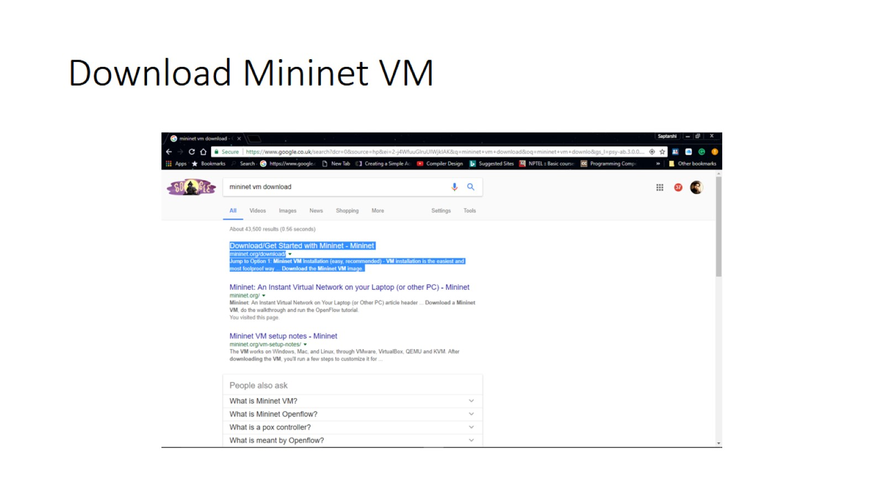
Download Mininet VM

Slide 3
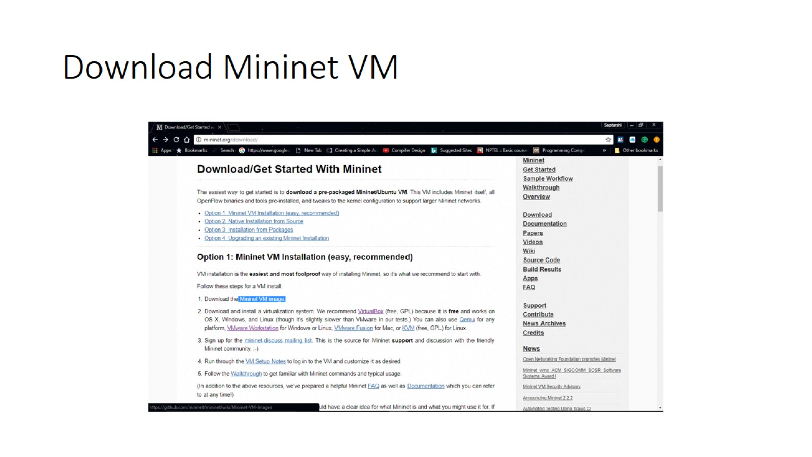
Download Mininet VM

Slide 4
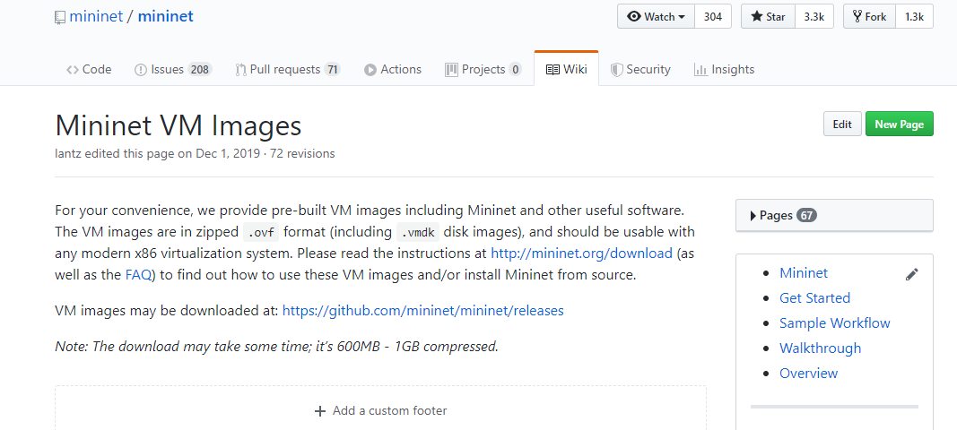
Download Mininet VM

Slide 5
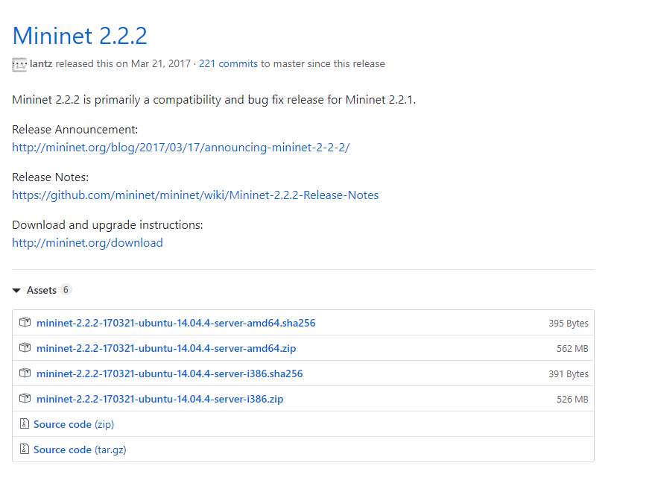
Download Mininet VM

Slide 6
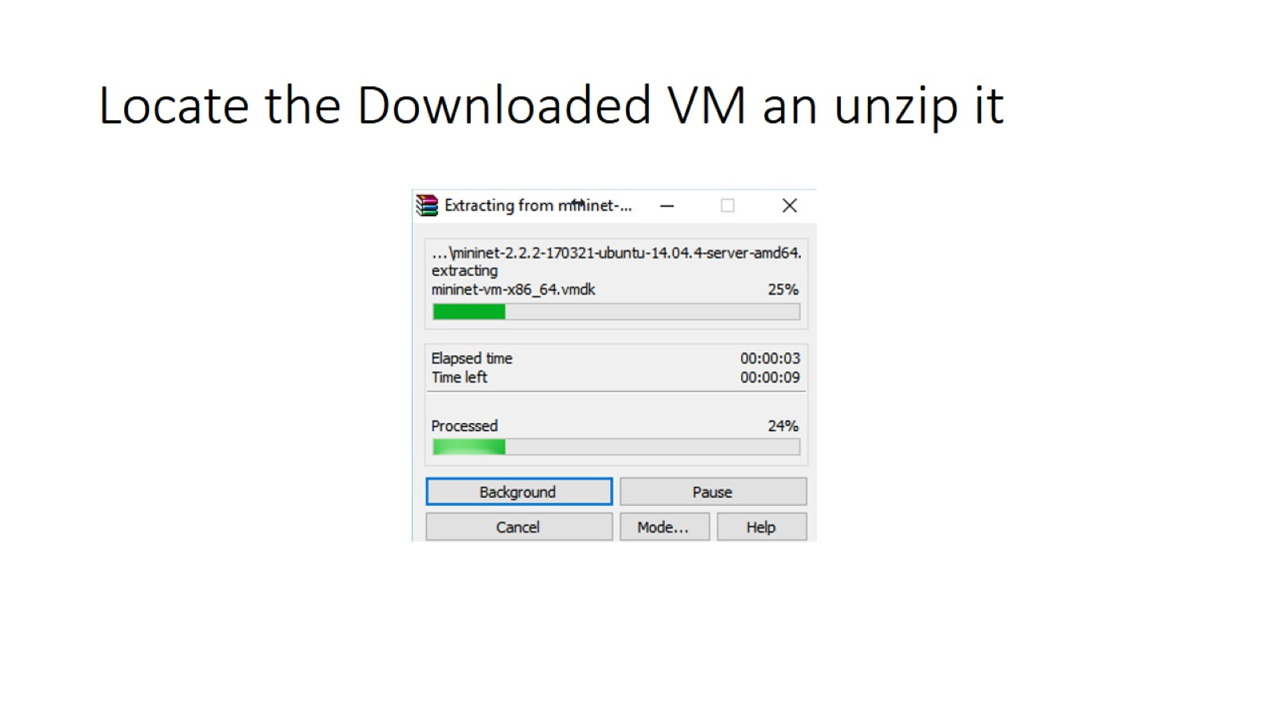
Locate the Downloaded VM an unzip it

Slide 7
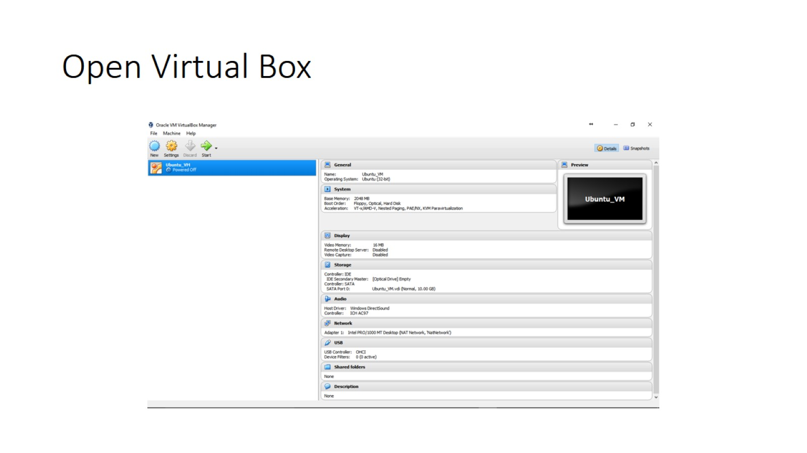
Open Virtual Box

Slide 8
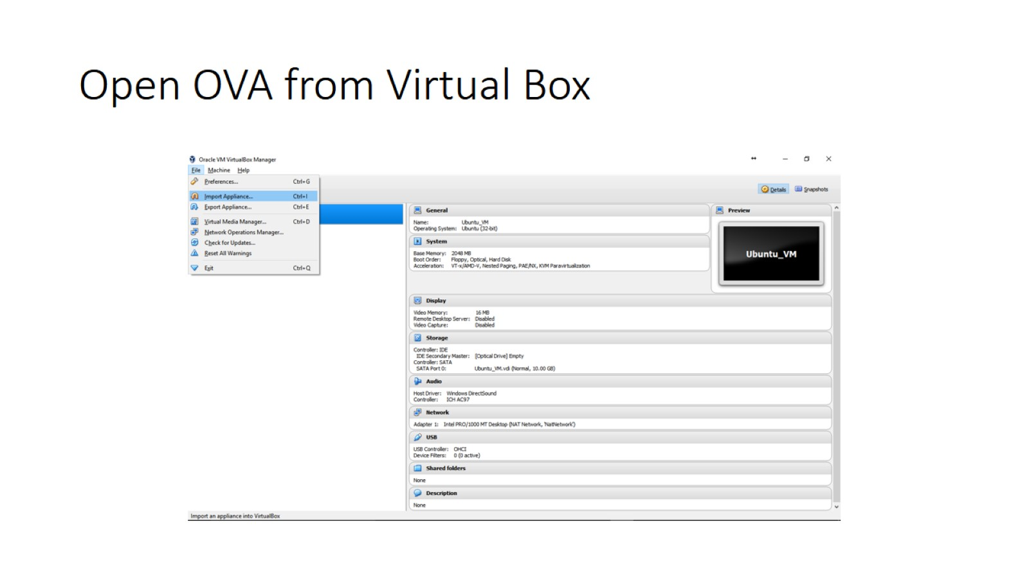
Open OVA from Virtual Box

Slide 9
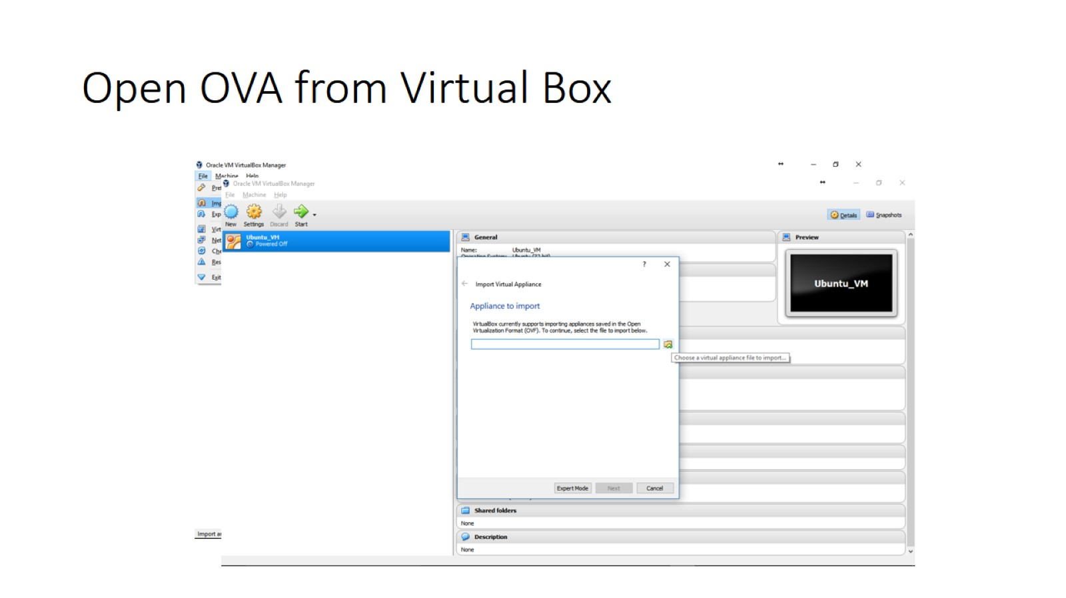
Open OVA from Virtual Box

Slide 10
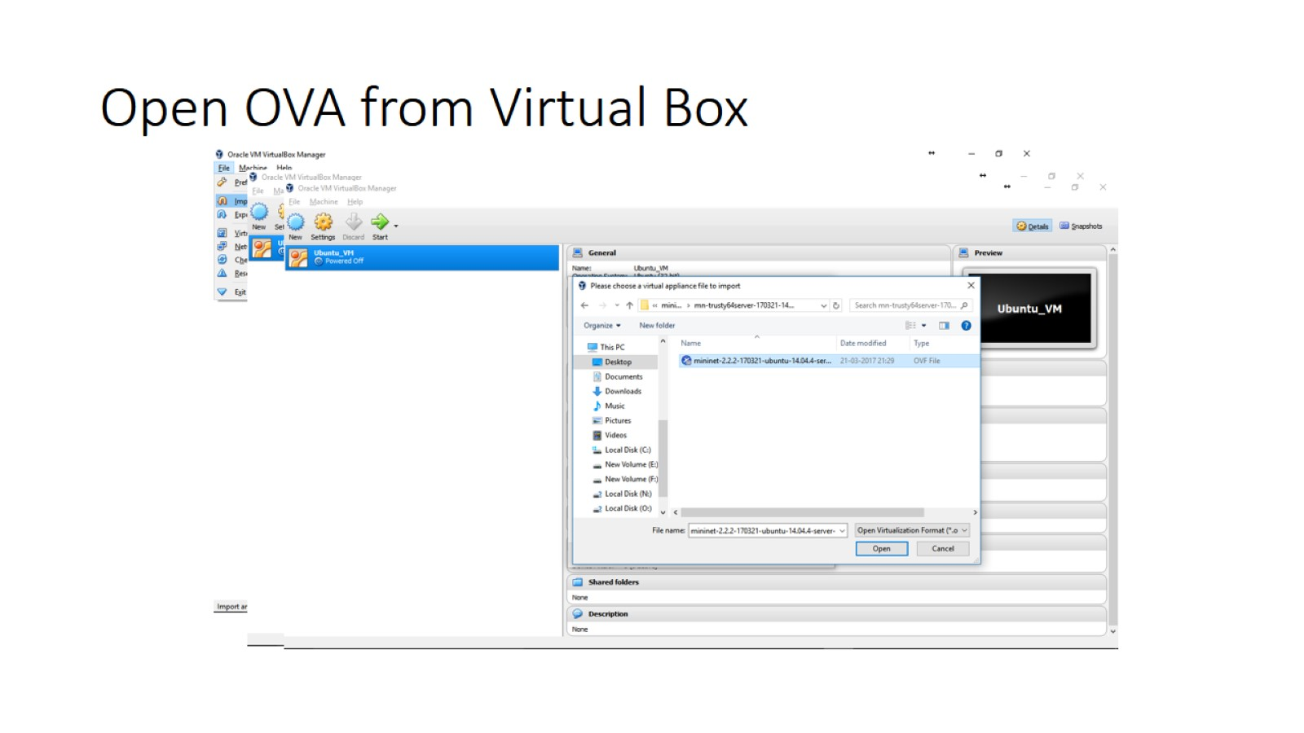
Open OVA from Virtual Box

Slide 11
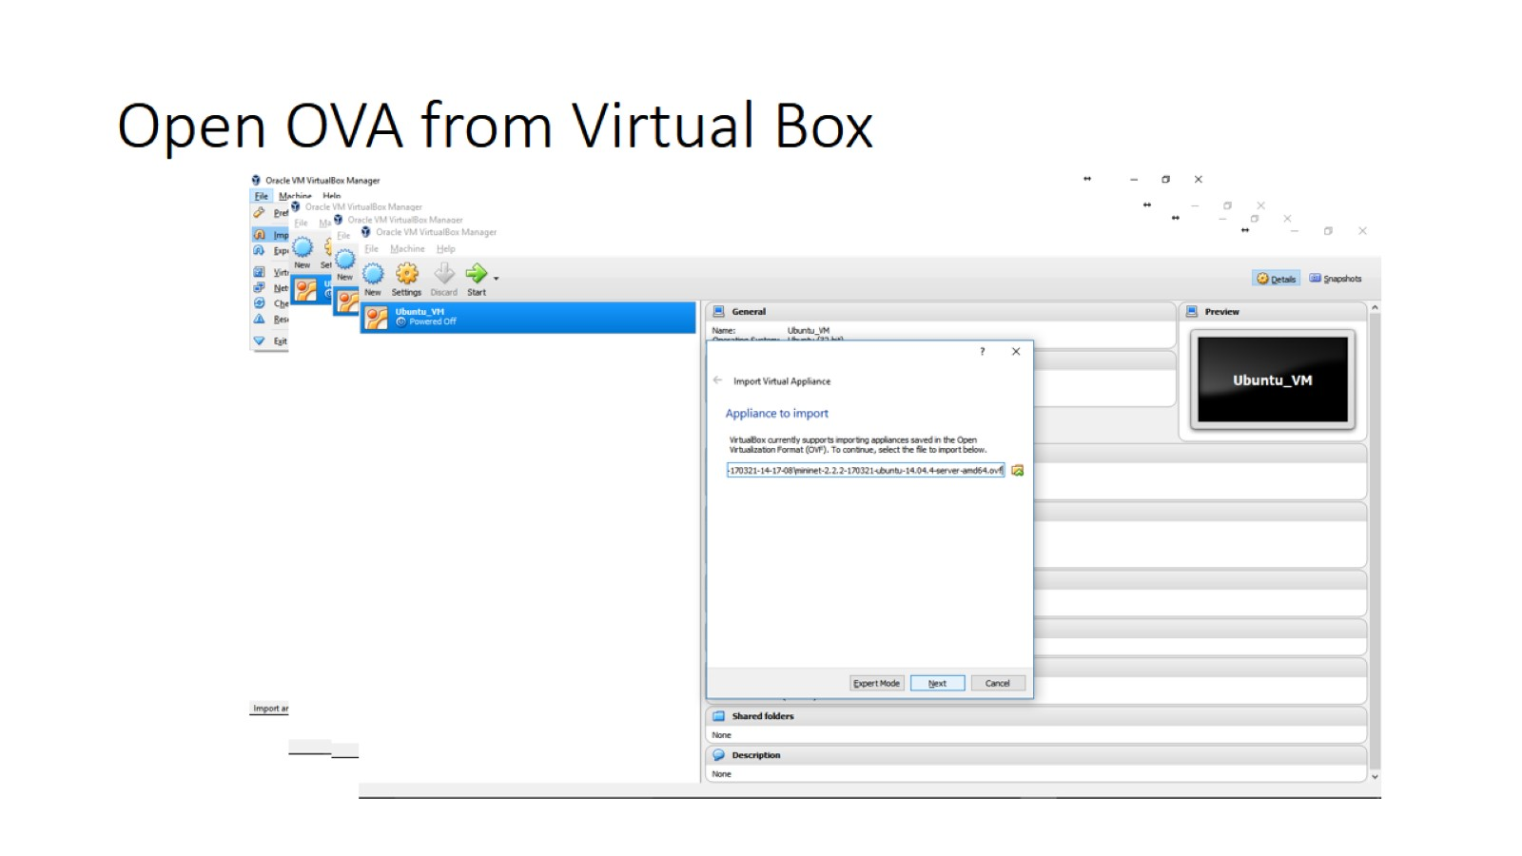
Open OVA from Virtual Box

Slide 12
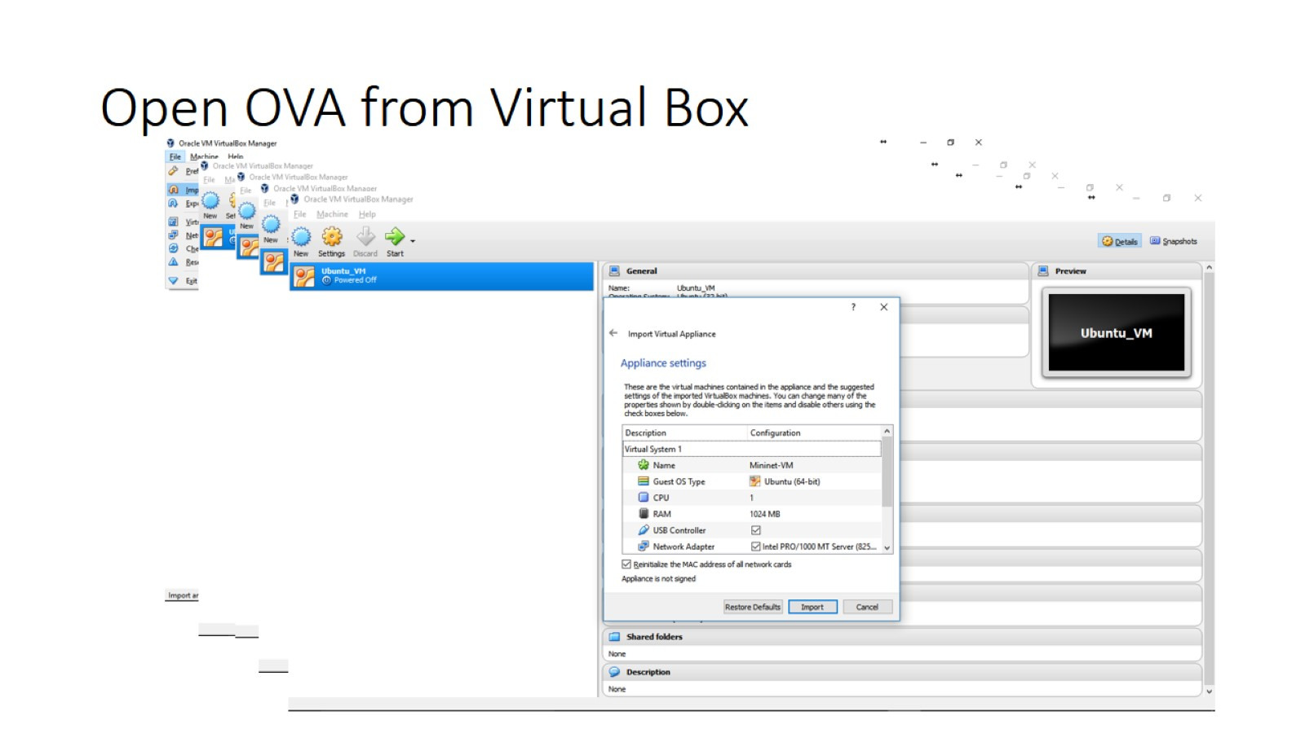
Open OVA from Virtual Box

Slide 13
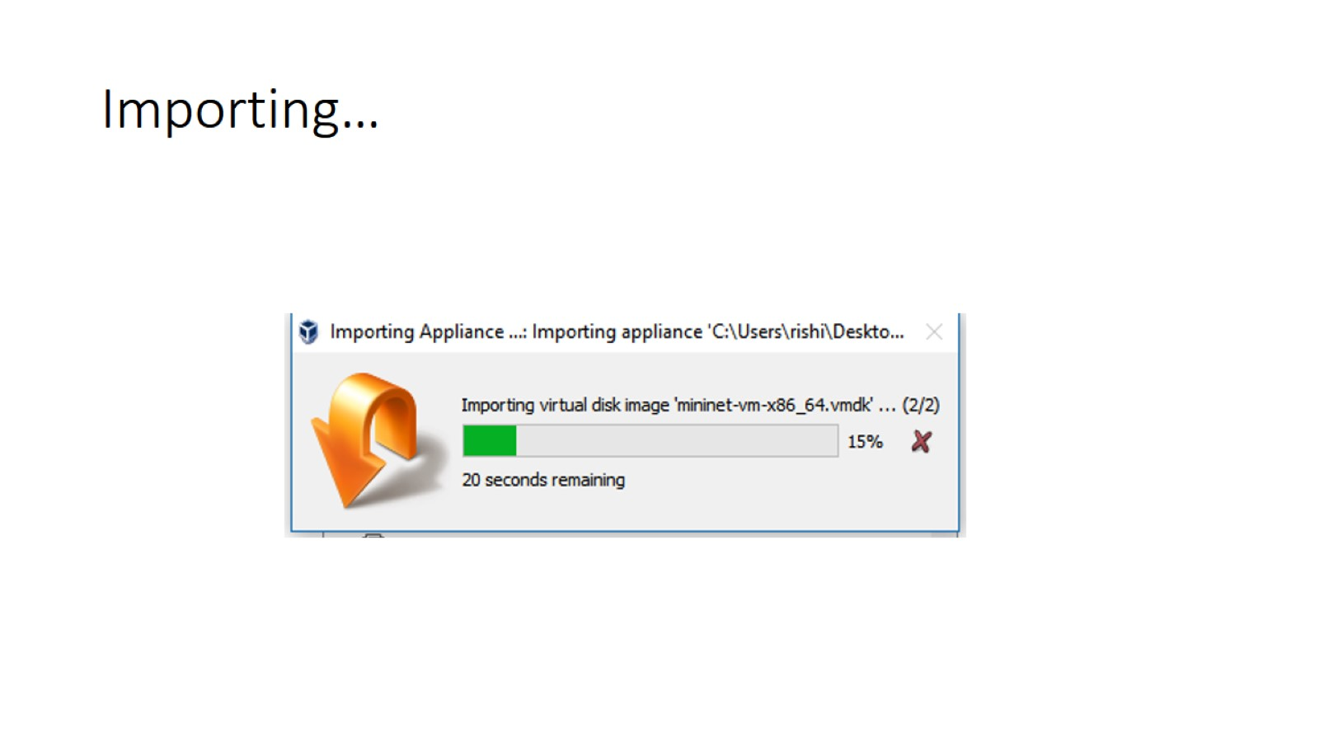
Importing…

Slide 14
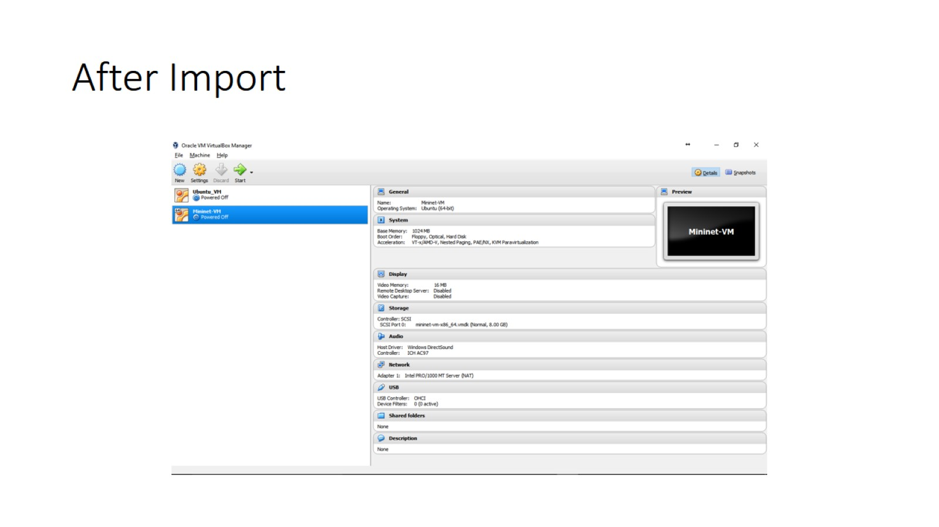
After Import
You should have 2 VMs in your virtual box one from last tutorial section.
And the mininet you just imported. If not, Download and import another vm
From the link

Slide 15
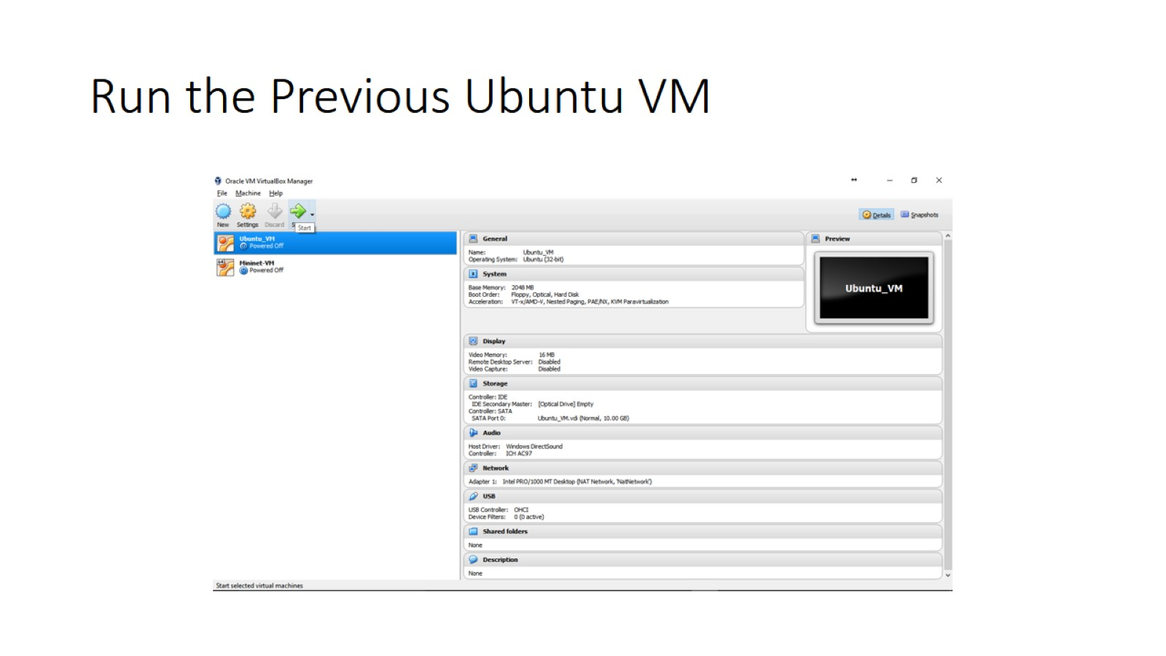
Run the Previous Ubuntu VM

Slide 16
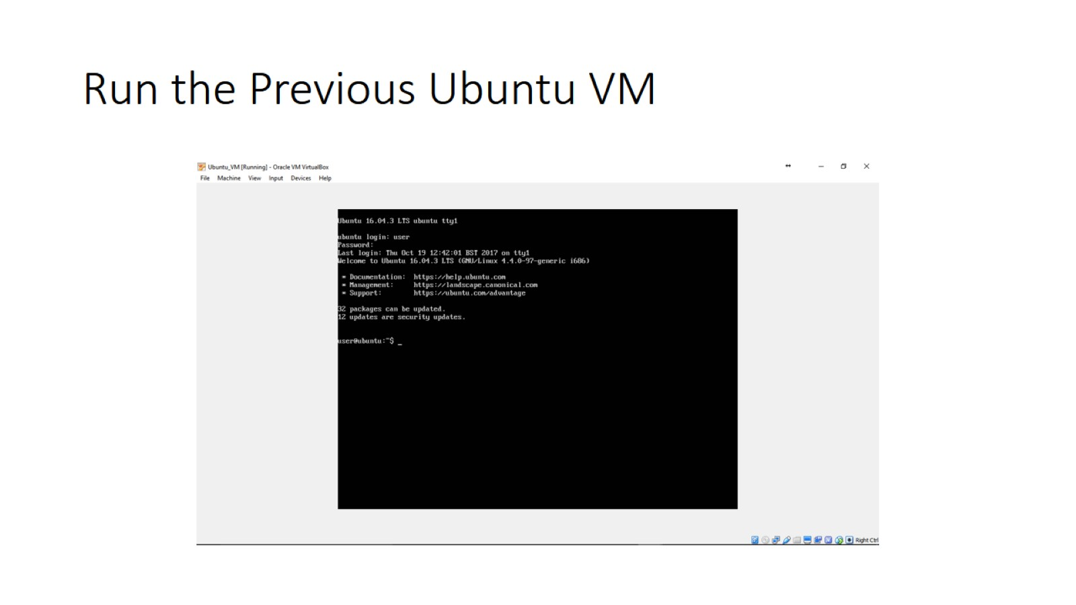
Run the Previous Ubuntu VM

Slide 17
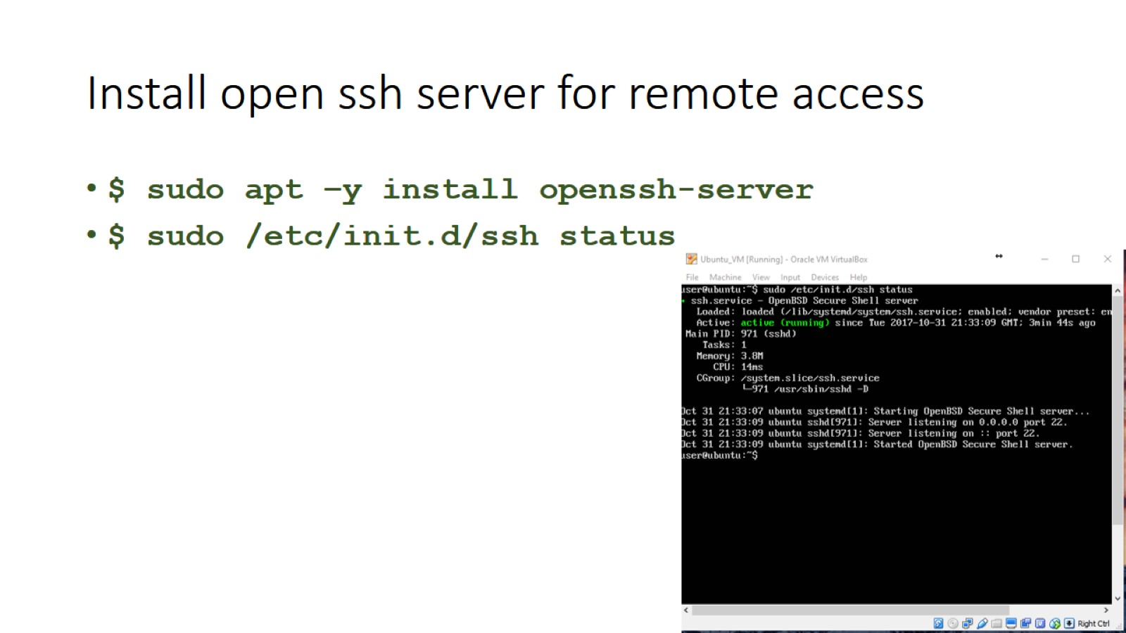
Install open ssh server for remote access

Slide 18
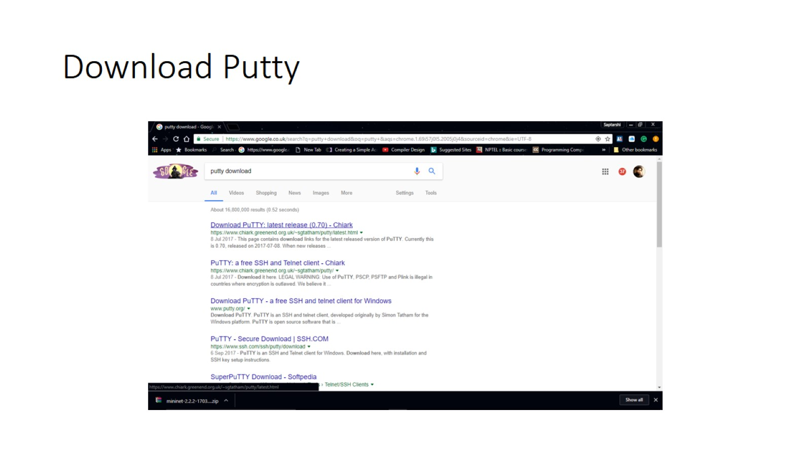
Download Putty

Slide 19
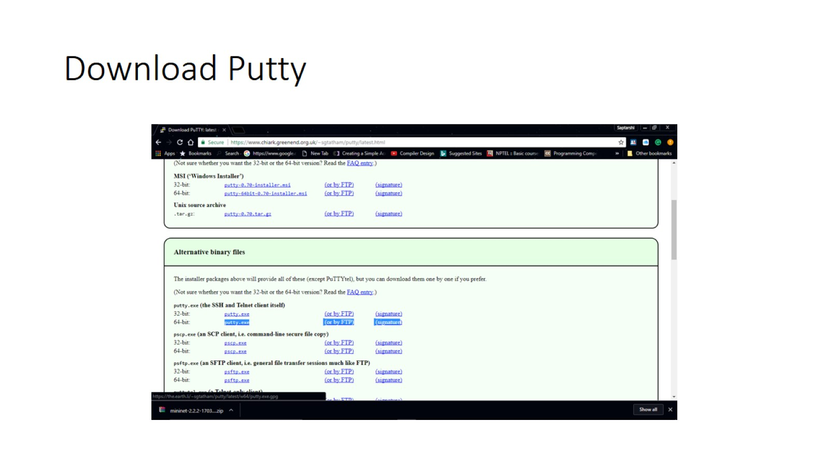
Download Putty

Slide 20
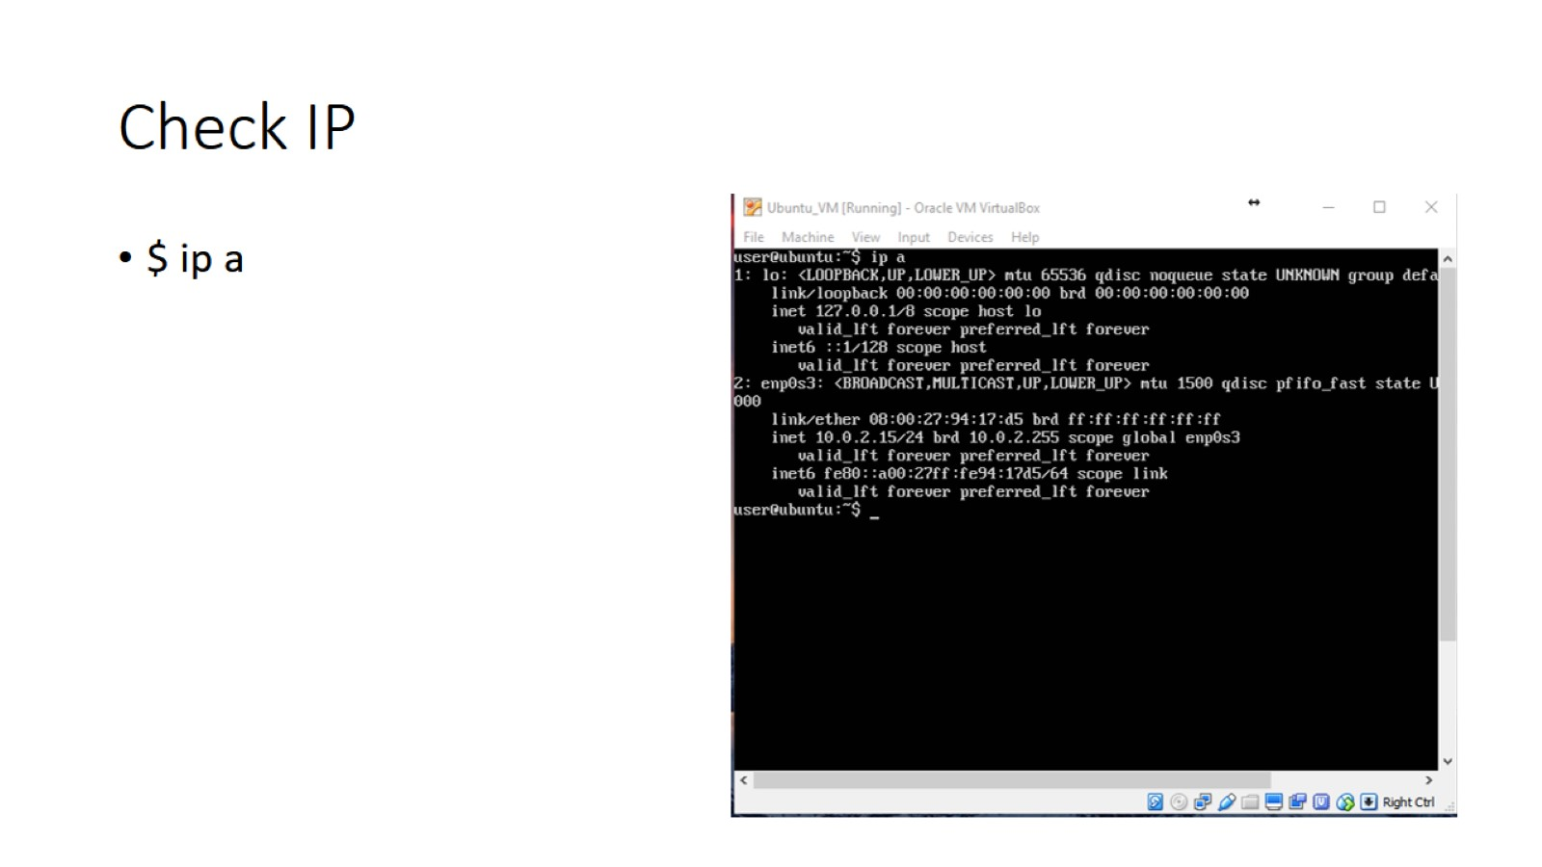
Check IP

Slide 21
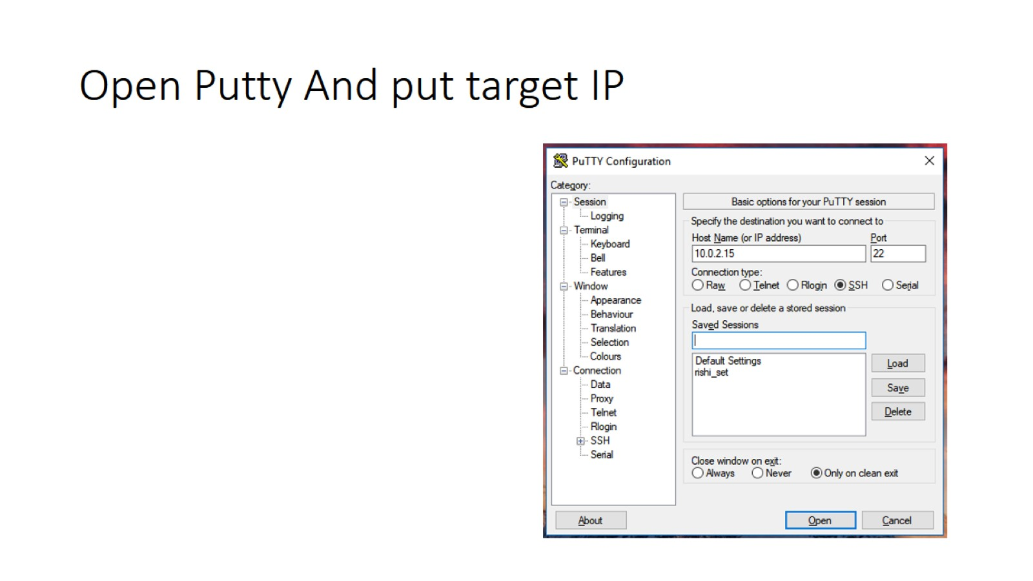
Open Putty And put target IP

Slide 22
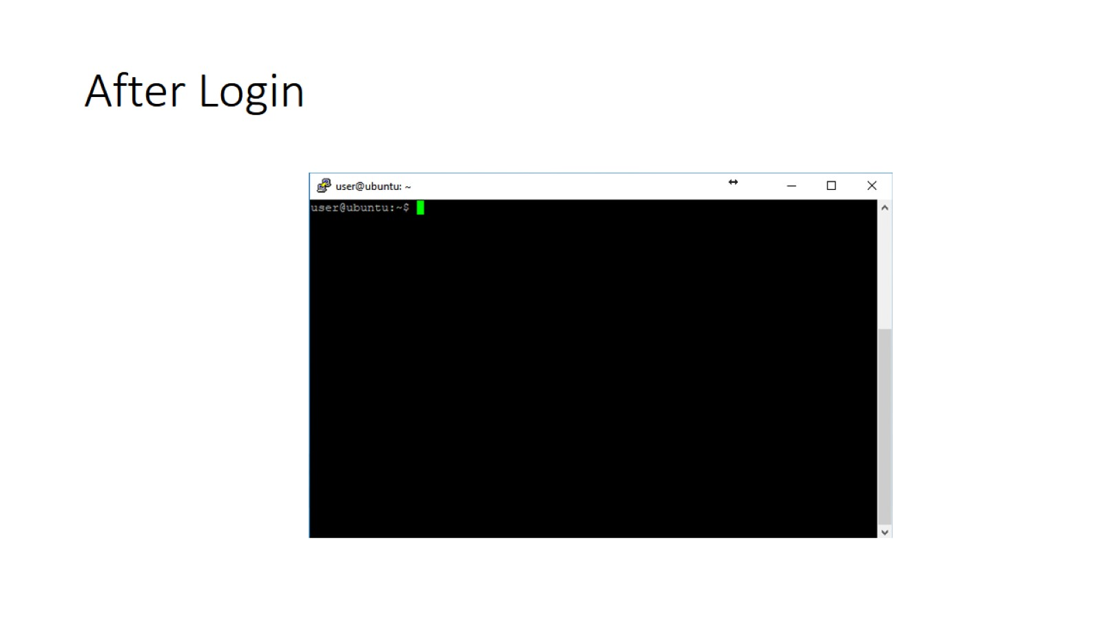
After Login

Slide 23
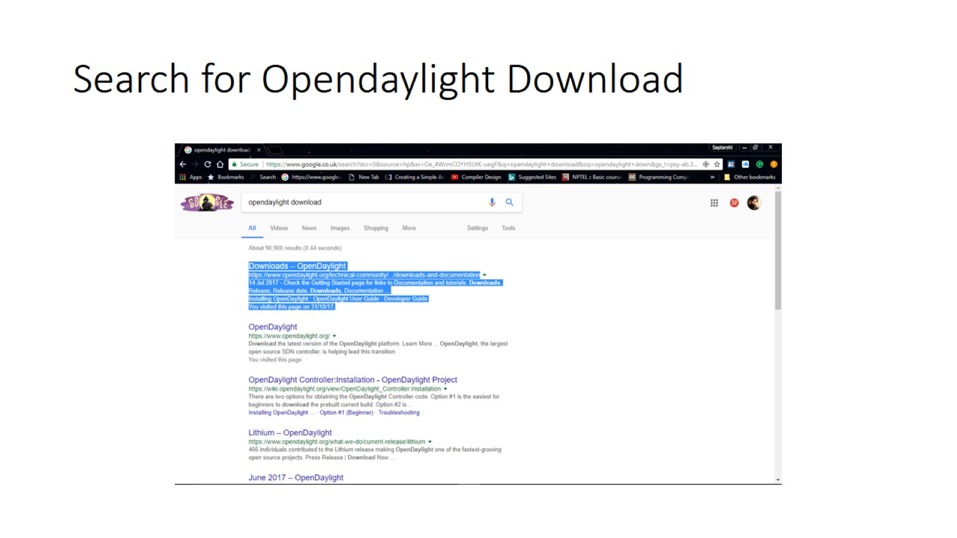
Search for Opendaylight Download

Slide 24
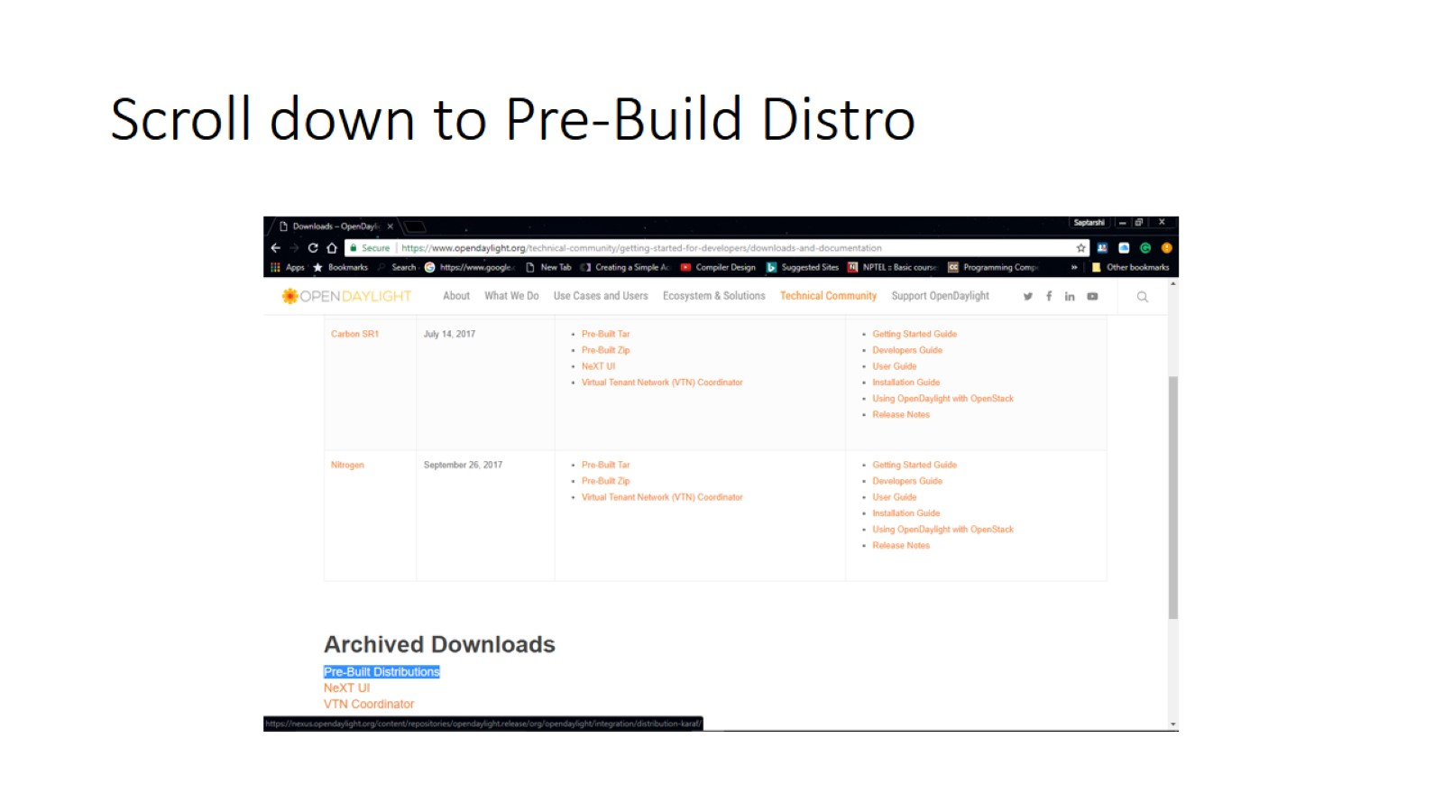
Scroll down to Pre-Build Distro

Slide 25
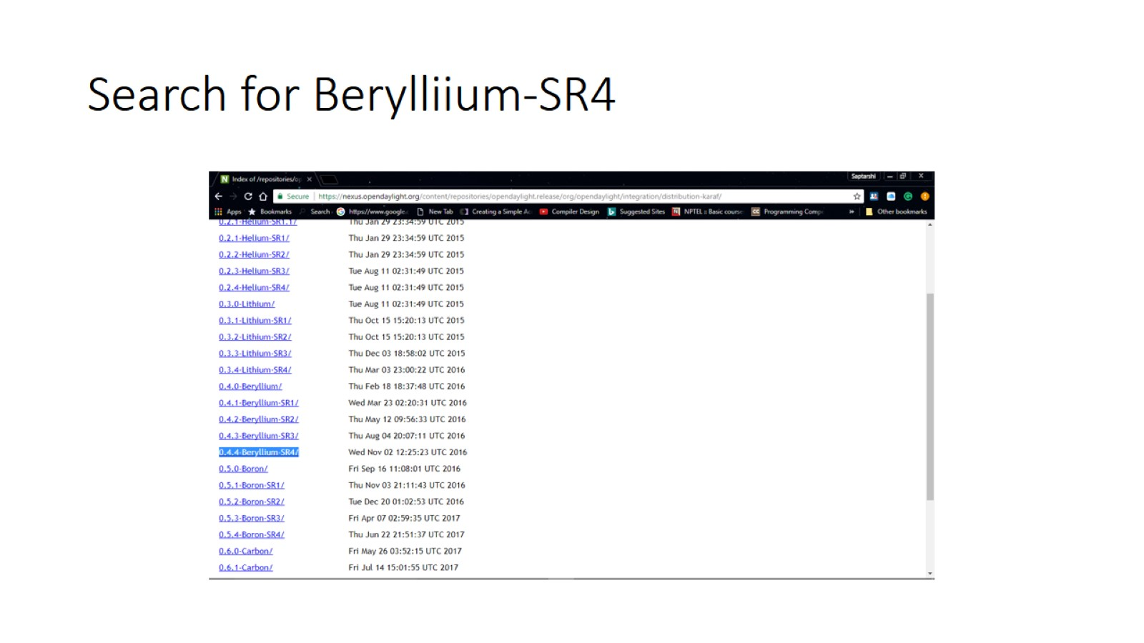
Search for Berylliium-SR4

Slide 26
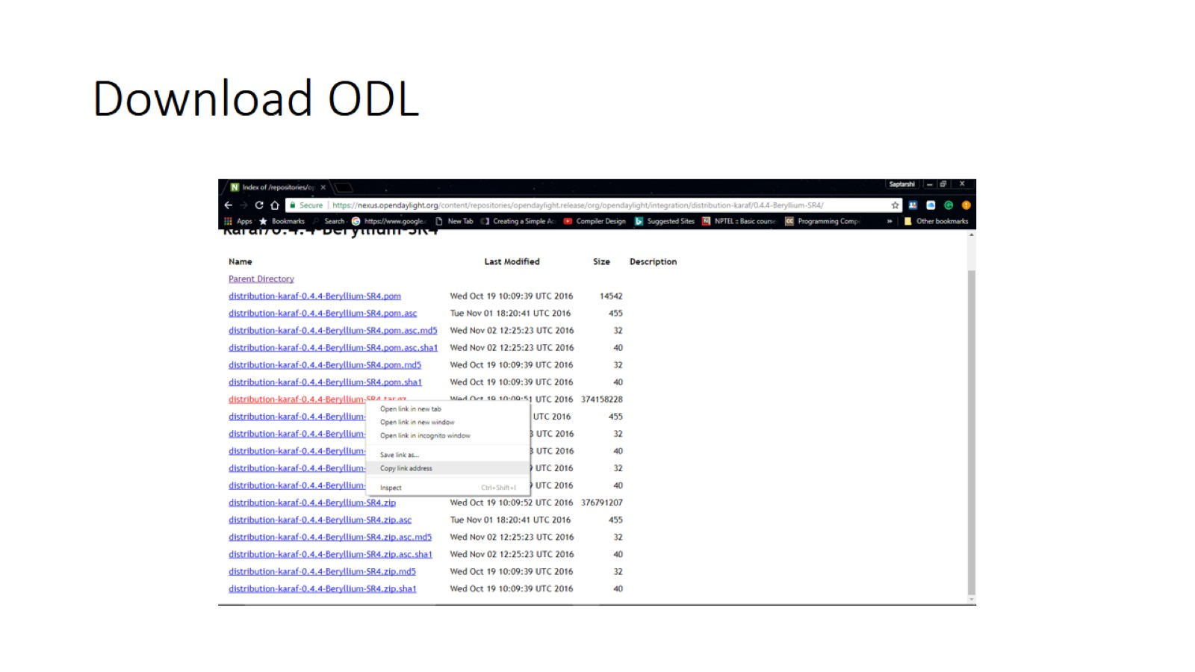
Download ODL

Slide 27
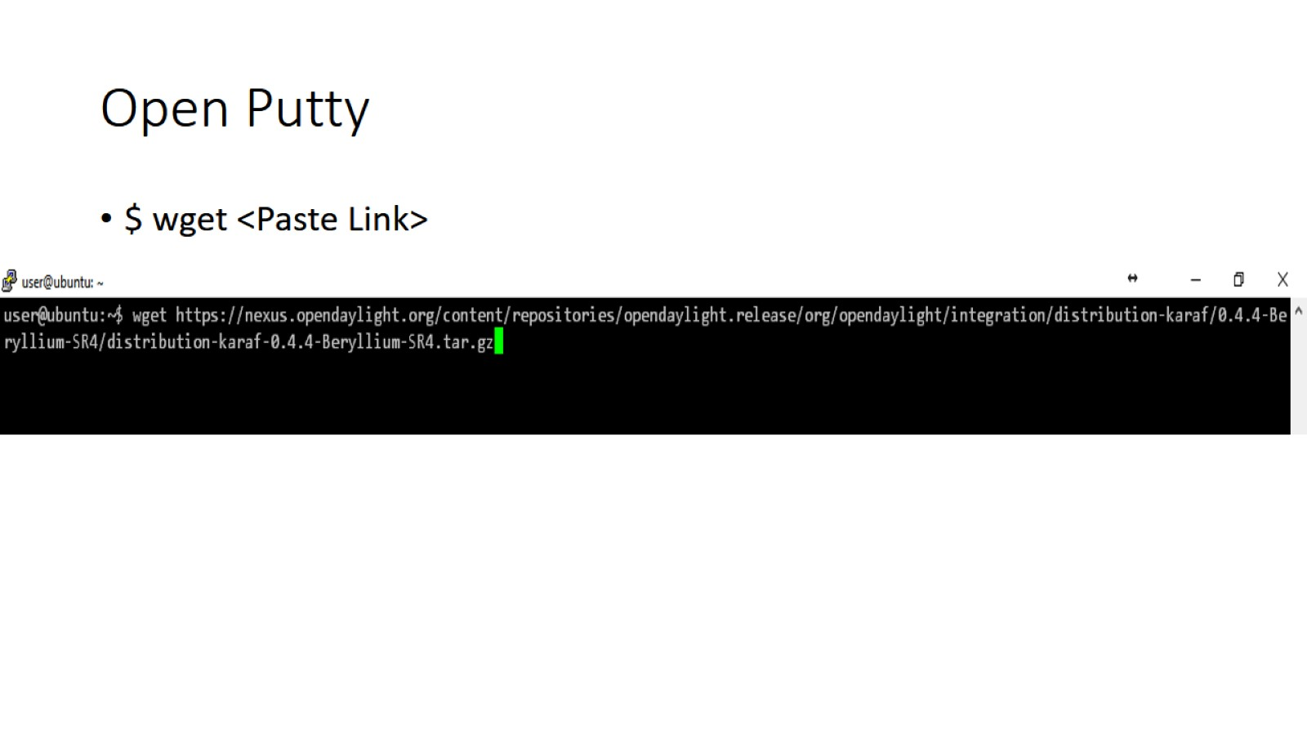
Open Putty

Slide 28
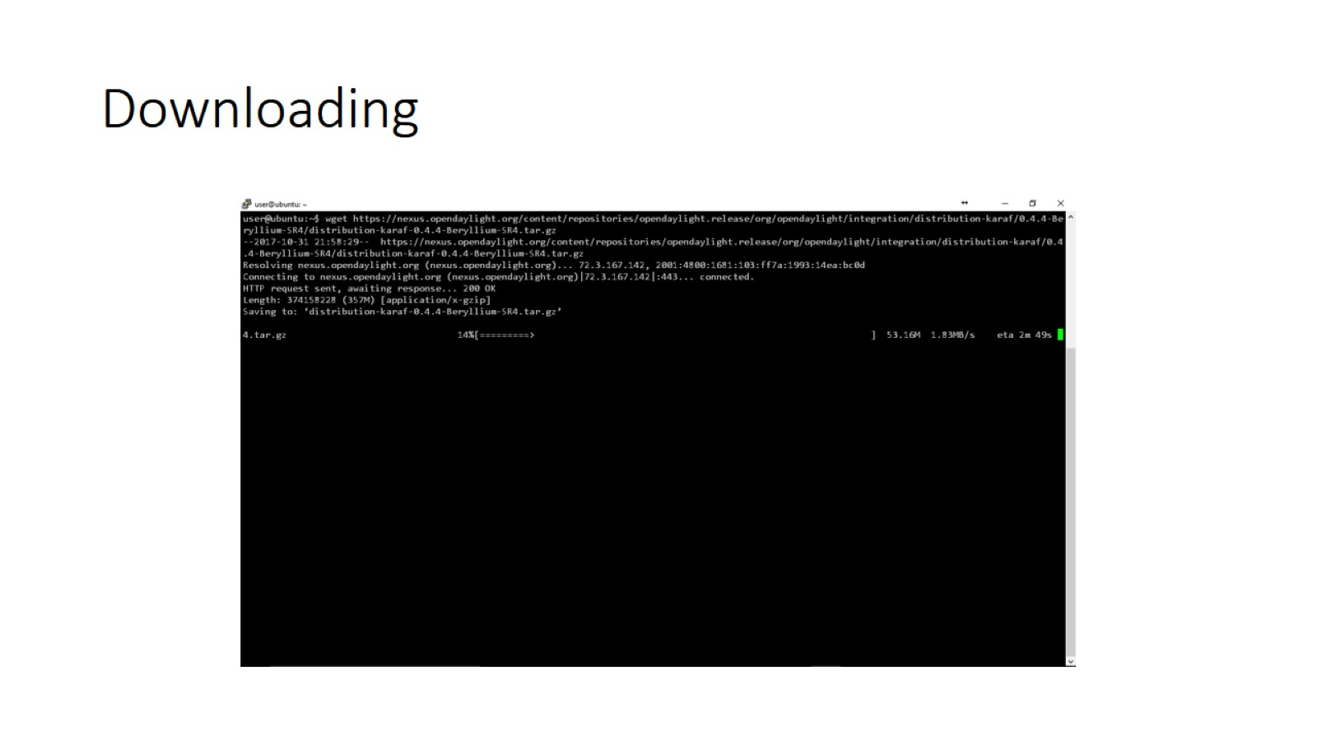
Downloading

Slide 29
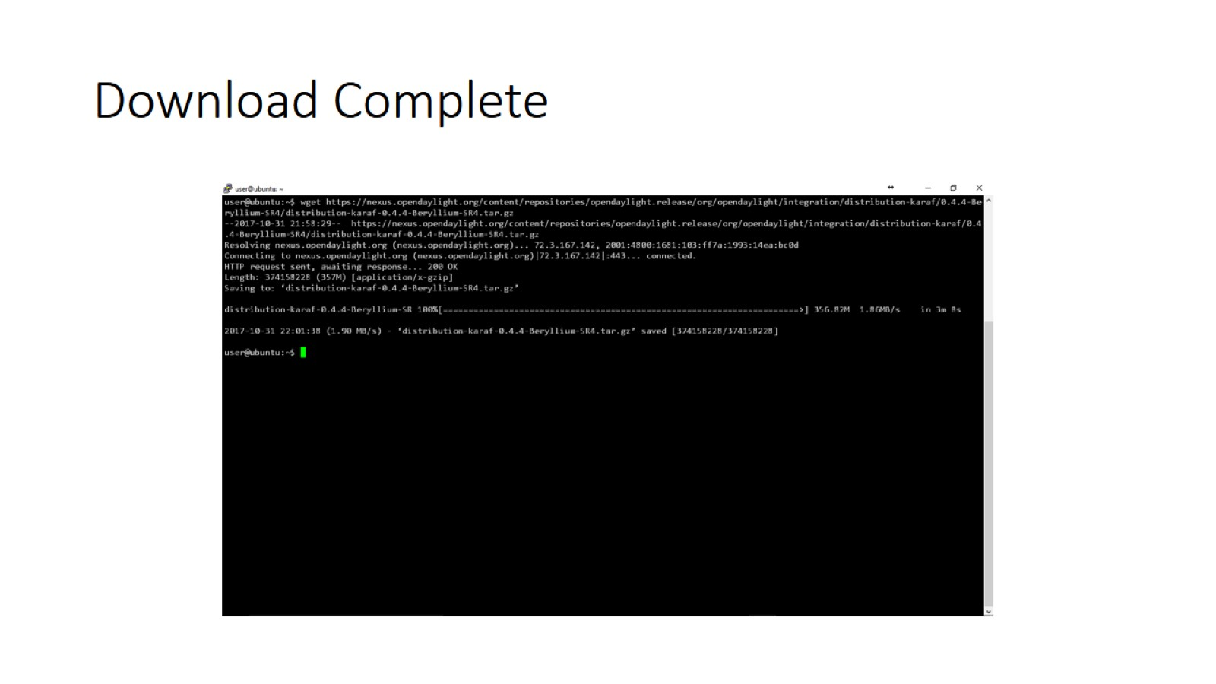
Download Complete

Slide 30
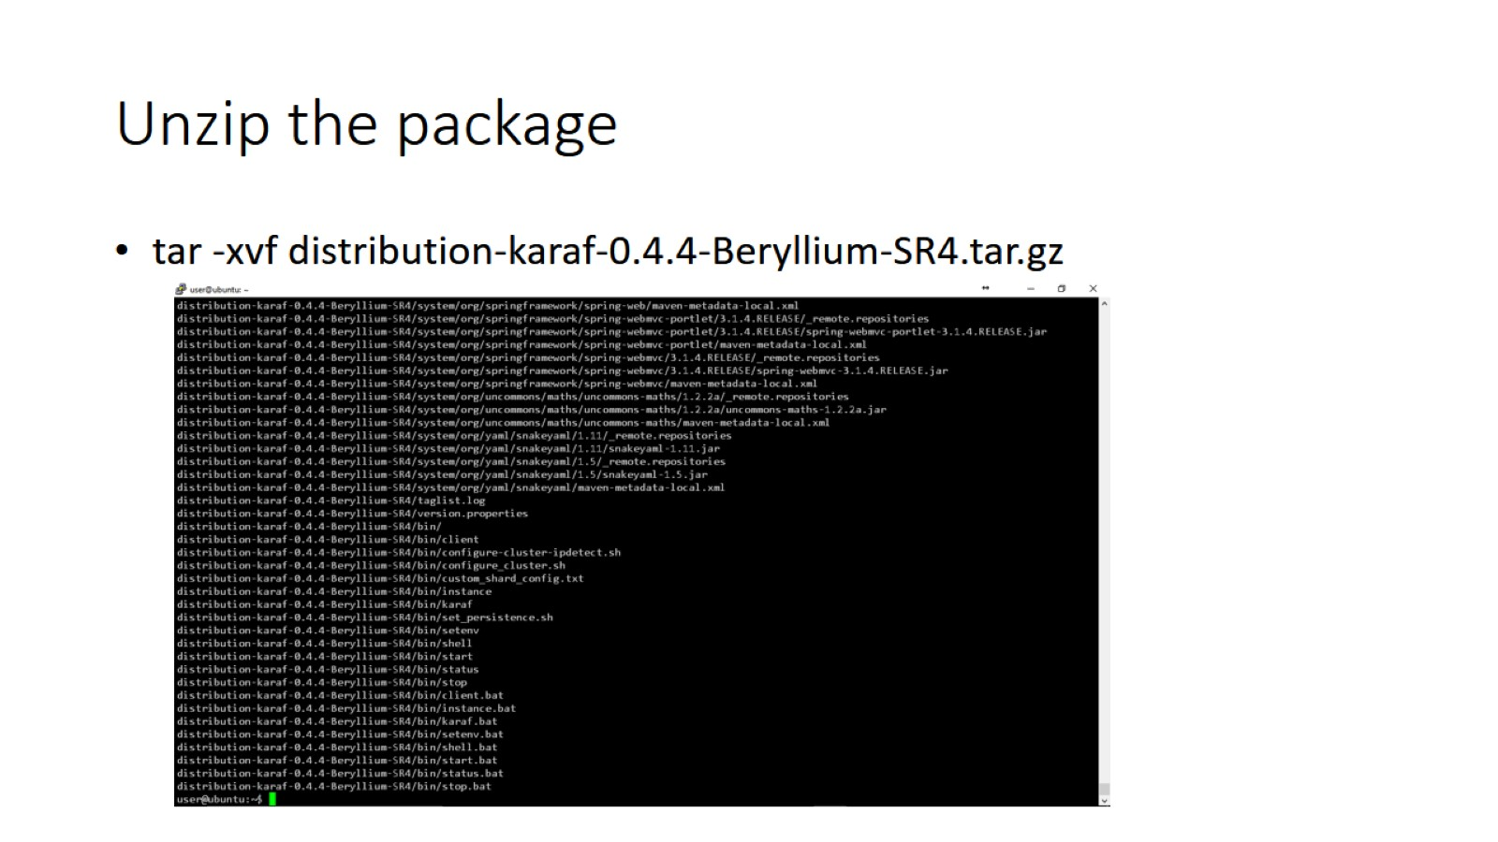
Unzip the package

Slide 31
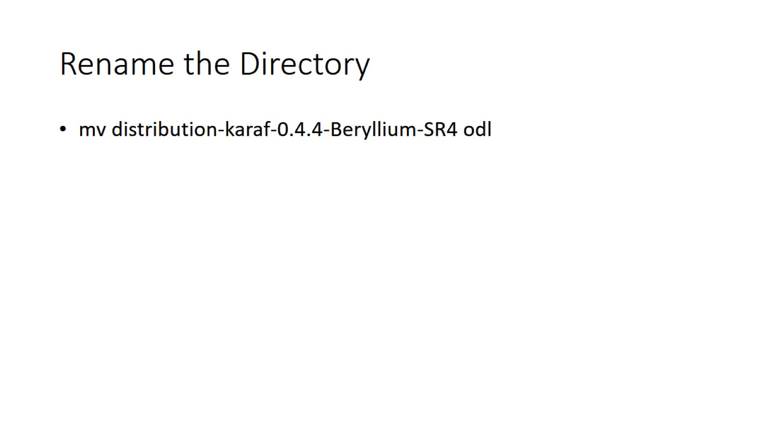
Rename the Directory

Slide 32
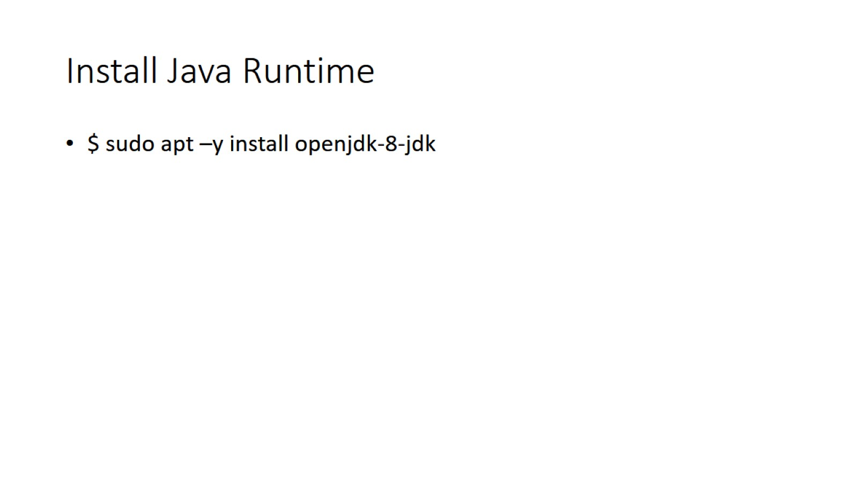
Install Java Runtime

Slide 33
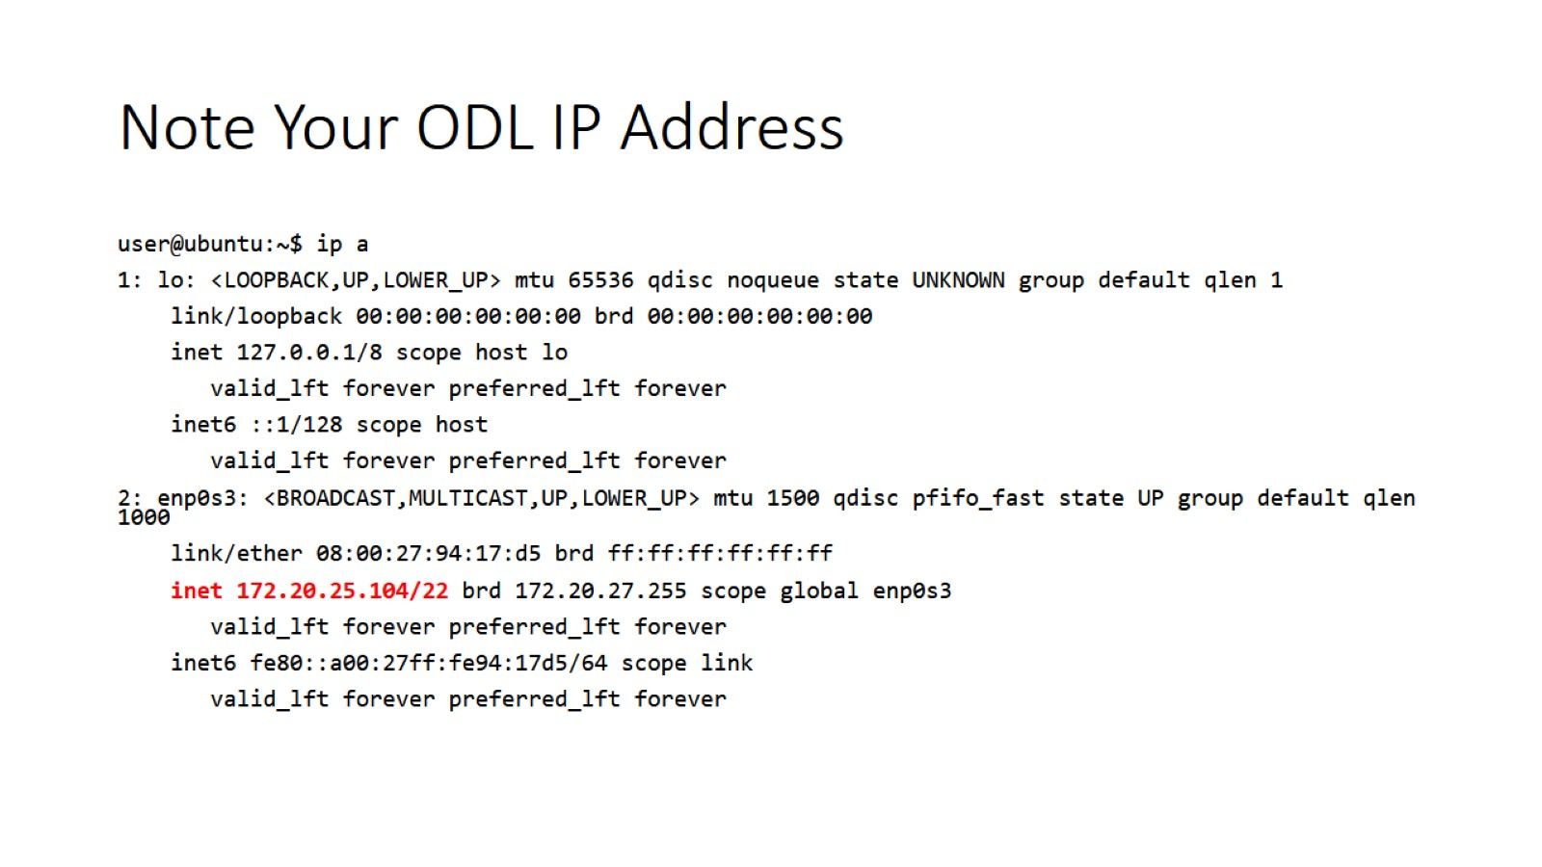
Note Your ODL IP Address

Slide 34
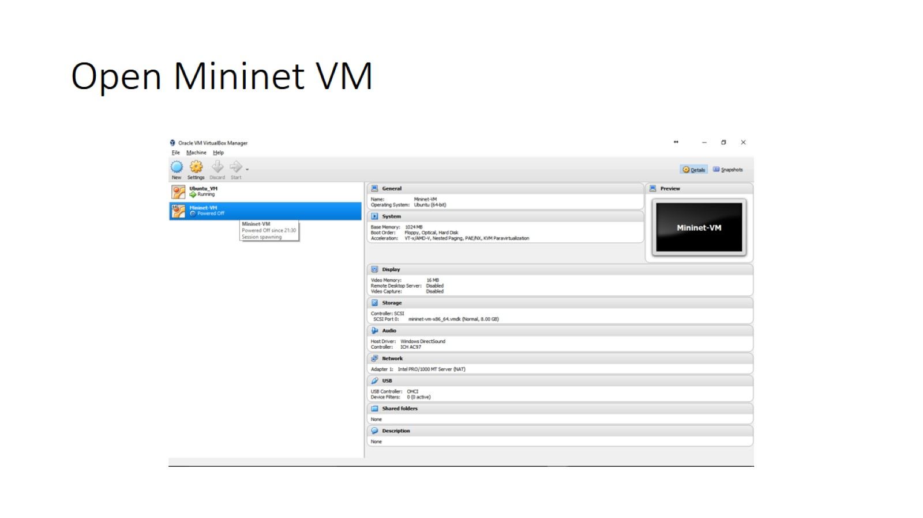
Open Mininet VM

Slide 35
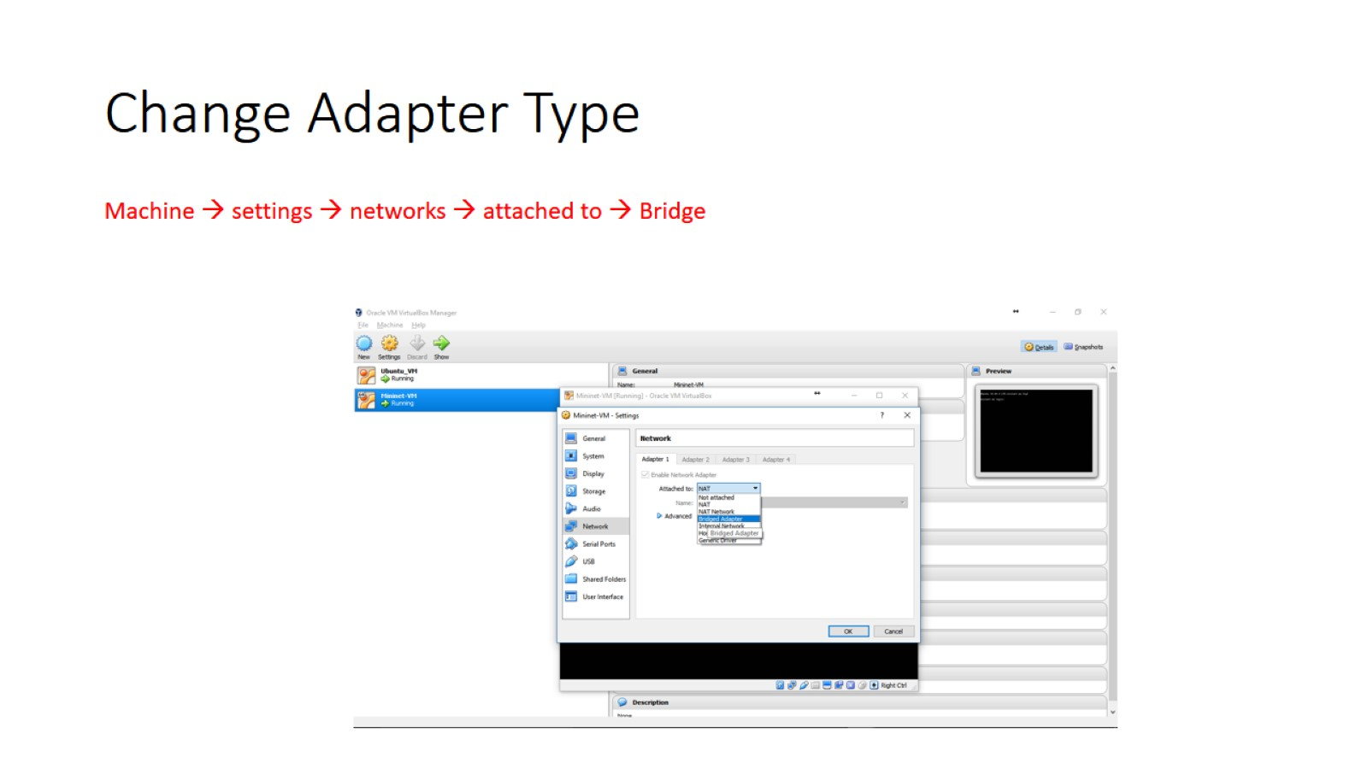
Change Adapter Type

Slide 36
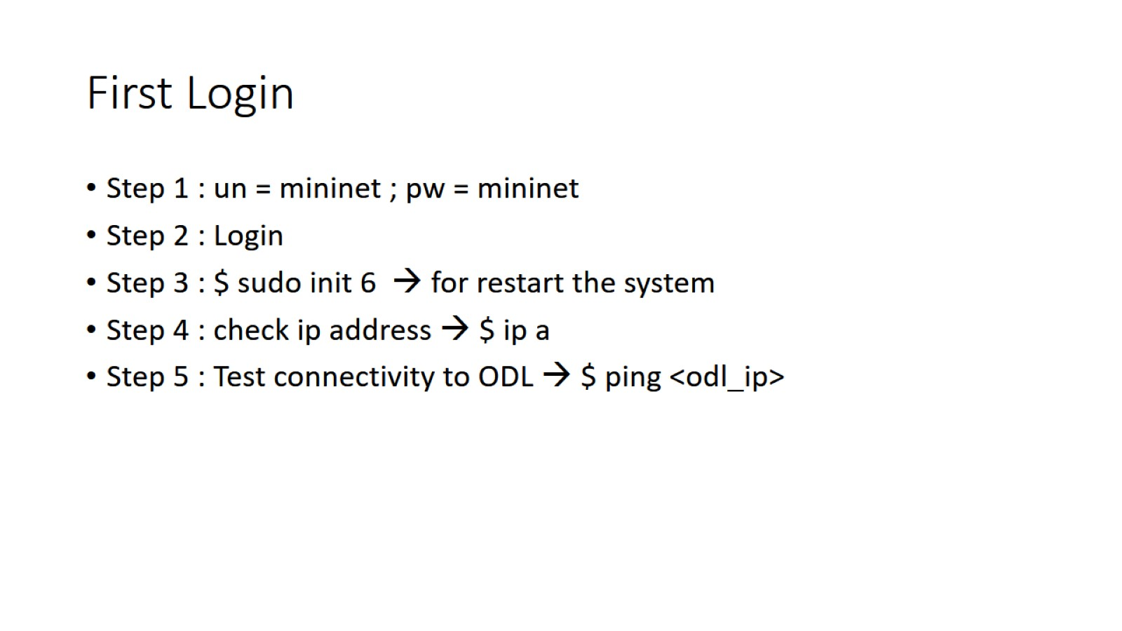
First Login

Slide 37
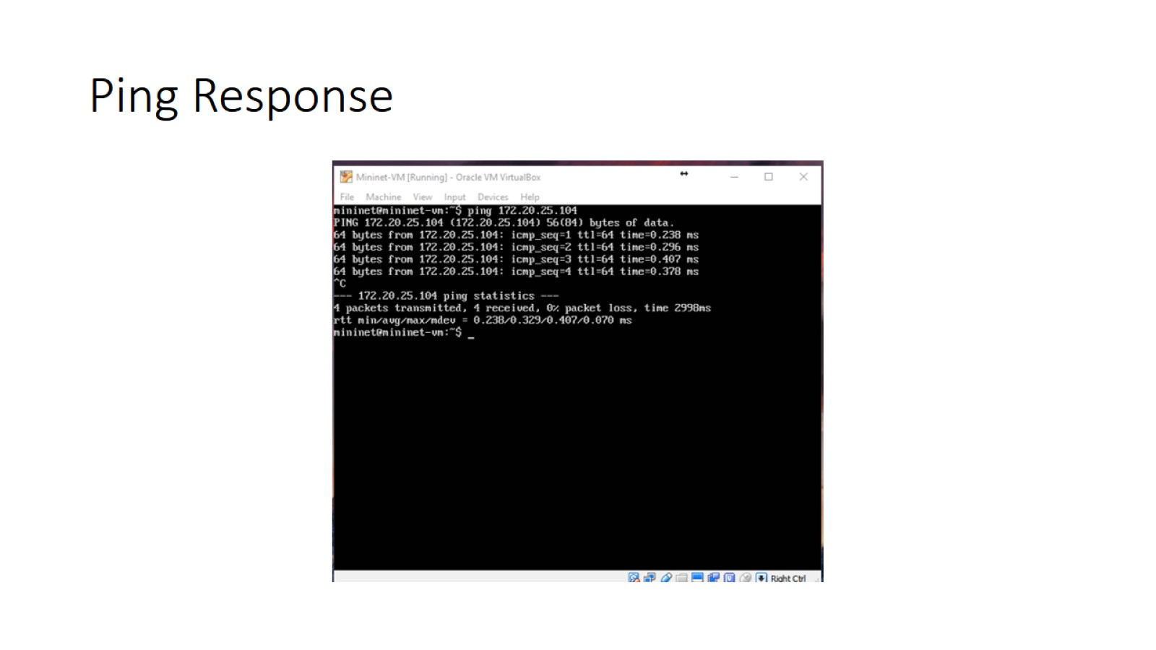
Ping Response

Slide 38
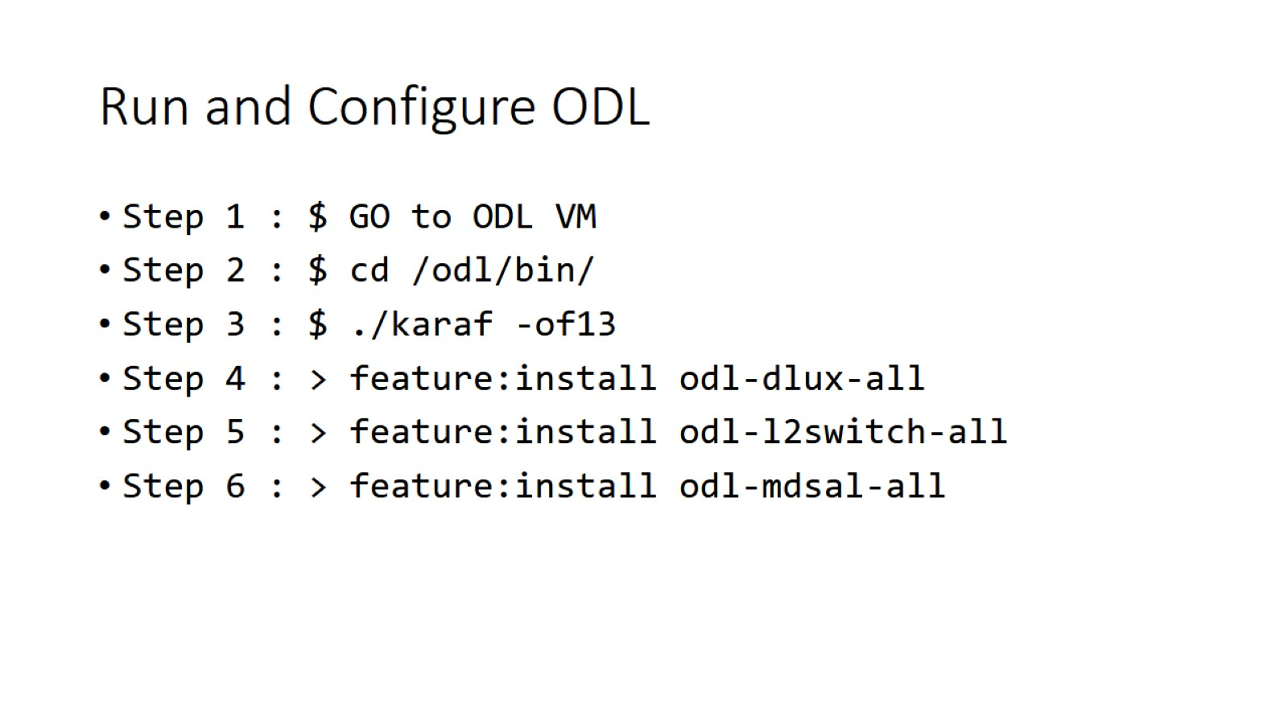
Run and Configure ODL

Slide 39
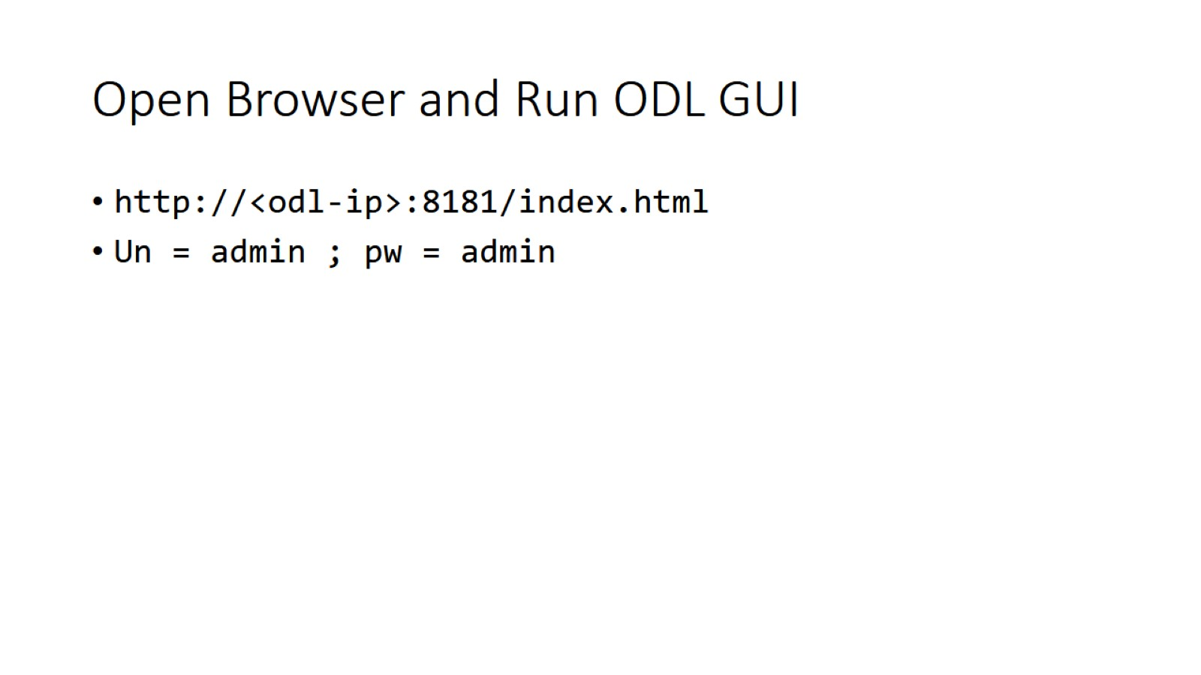
Open Browser and Run ODL GUI

Slide 40
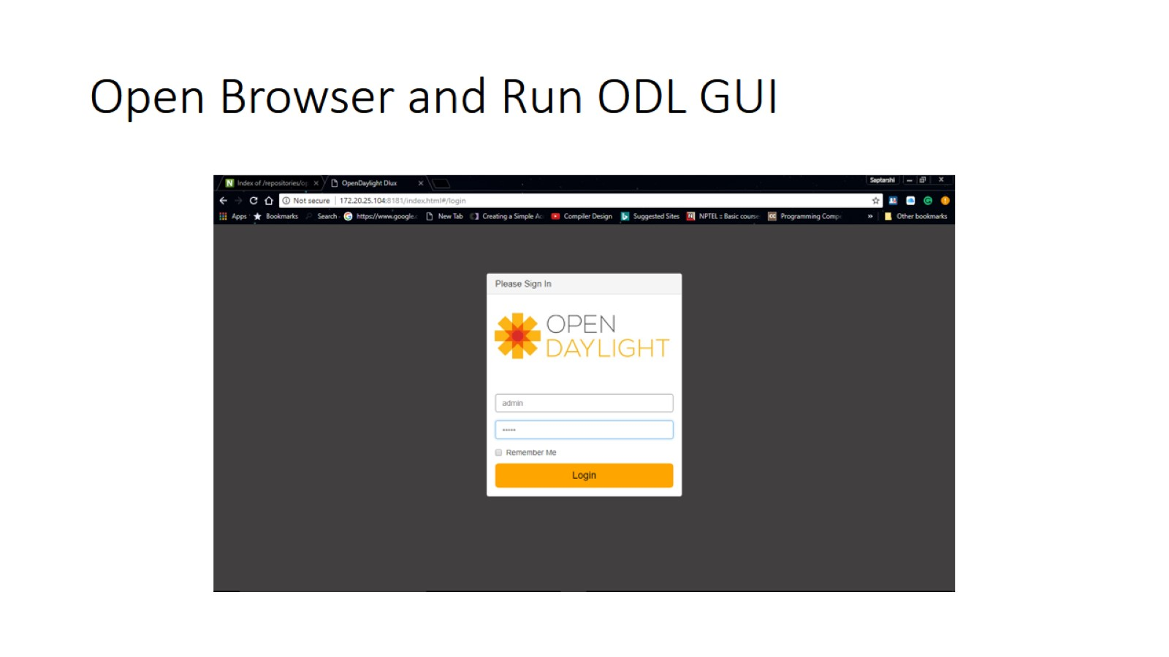
Open Browser and Run ODL GUI

Slide 41
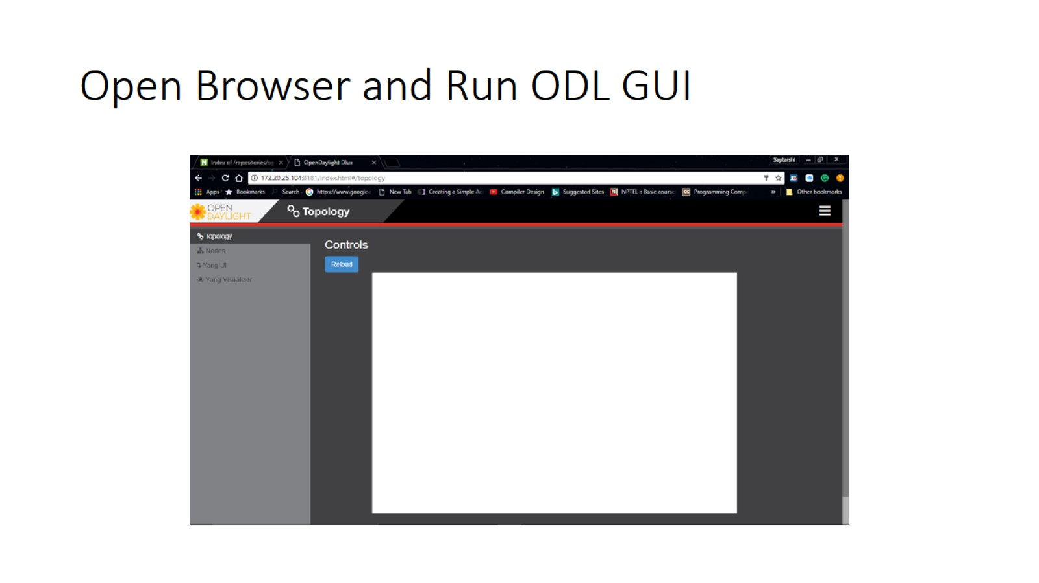
Open Browser and Run ODL GUI

Slide 42
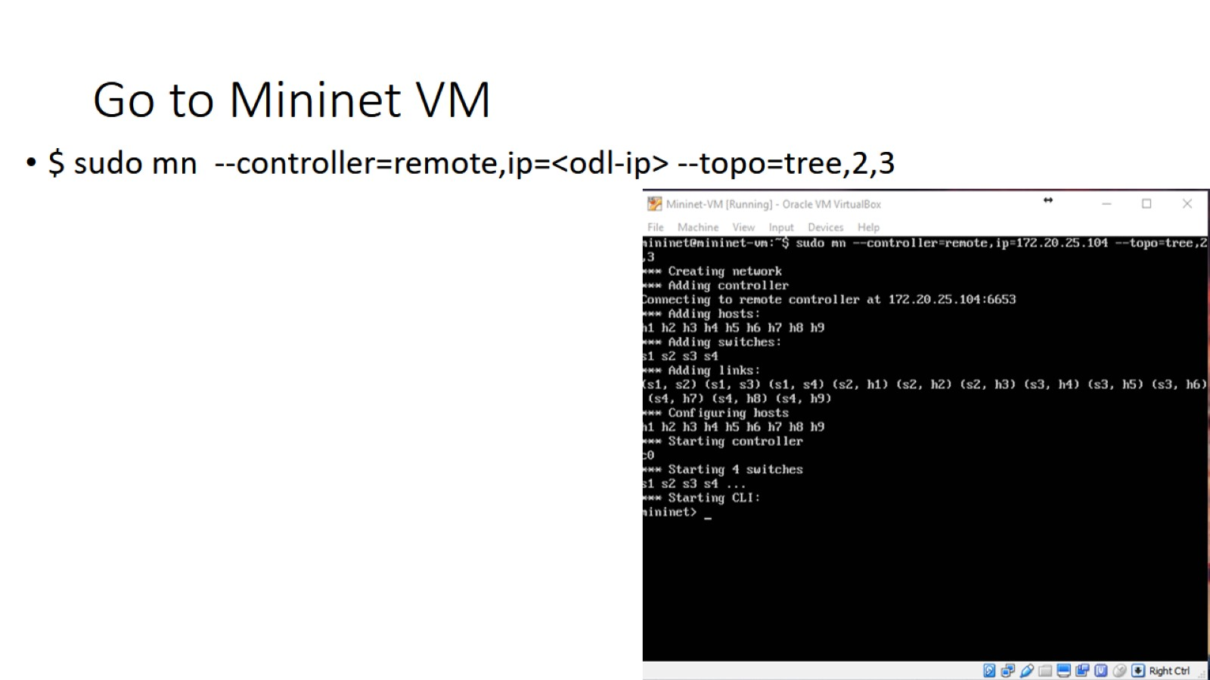
Go to Mininet VM

Slide 43
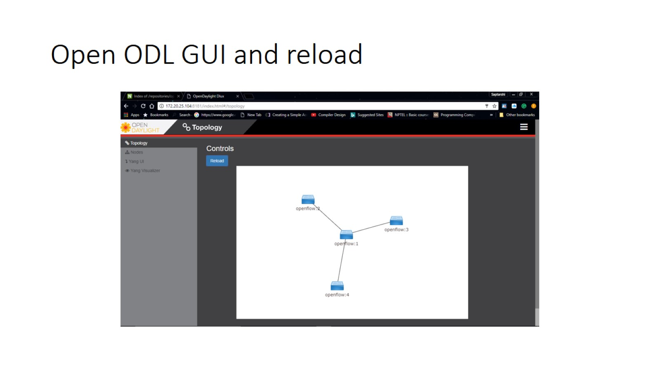
Open ODL GUI and reload

Slide 44
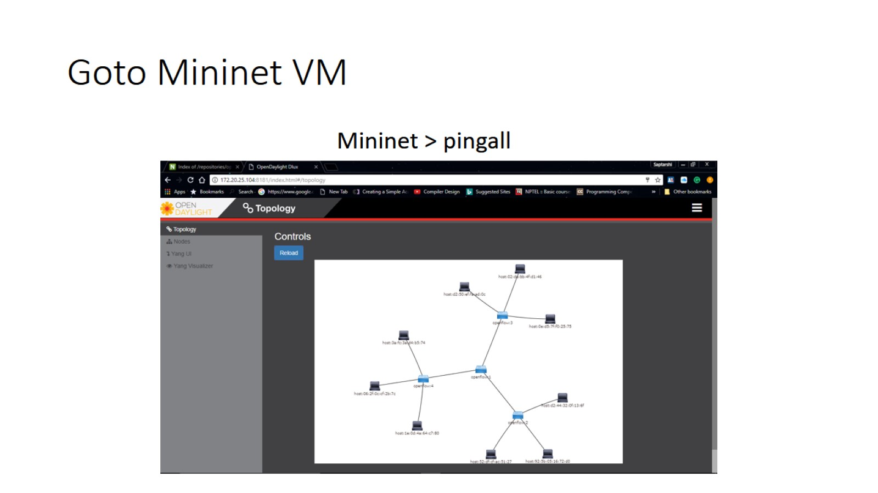
Goto Mininet VM

Slide 45
Task
Create a topology with tree3,3
Create a topology with linear3,3
Explore more about Mininet
http://mininet.org/walkthrough/

